Slide 1
Checking and securing understanding of negative numbers in context
Arithmetic procedures with integers and decimals

Slide 2
how to use Oak lessons

Slide 3
I can interpret negative numbers in context and can think about negative numbers without context.

Slide 4
integer

Slide 5
An integer is any positive or negative whole number or zero. E.g. (−2), 0, 153 are all examples of integers.

Slide 6

Checking and securing understanding of negative numbers in context
Reviewing negative numbers in a context
Using negative numbers in a context

Slide 7
Reviewing negative numbers in a context
Alex places a dot on a number line.
It is five away from zero.
Where might Alex’s dot be?
Lucas places a dot on a number line.
It is one hundred away from one.
Where might Lucas’ dot be?
Aisha places a dot on a number line.
It is seven away from three.
Where might Aisha’s dot be?
Jun places a dot on a number line.
It is one away from one quarter.
Where might Jun’s dot be?
In each situation there are two possible answers.
How far apart are the answers?

Slide 8
Reviewing negative numbers in a context
Alex places a dot on a number line.
It is five away from zero.
Where might Alex’s dot be?
5
5
−10
−9
−8
−7
−6
−5
−4
−3
−2
−1
0
1
2
3
4
5
6
7
8
9
10
Alex’s dot could be at (−5) or 5

Slide 9
Reviewing negative numbers in a context
Aisha places a dot on a number line.
It is seven away from three.
Where might Aisha’s dot be?
7
7
−10
−9
−8
−7
−6
−5
−4
−3
−2
−1
0
1
2
3
4
5
6
7
8
9
10
Aisha’s dot could be at (−4) or 10

Slide 10
Reviewing negative numbers in a context
Lucas places a dot on a number line.
It is one hundred away from one.
Where might Lucas’ dot be?
100
100
(−99)
1
101
Lucas’ dot could be at (−99) or 101

Slide 11


Reviewing negative numbers in a context
Jun places a dot on a number line.
It is one away from one quarter.
Where might Jun’s dot be?
1
1
Jun’s dot could be at or
In each situation the answers were double the distance away.
Will there always be a positive and negative answer?
No, for example three away from 10 would give 7 and 13

Slide 12

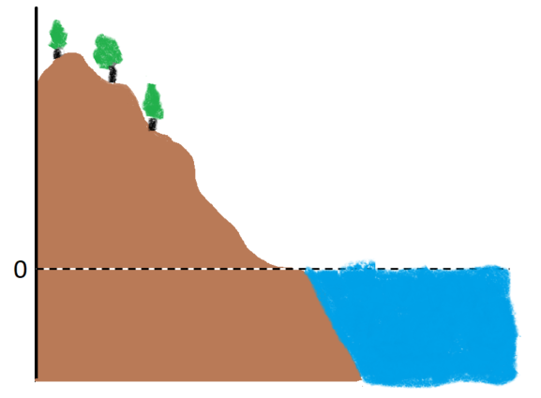
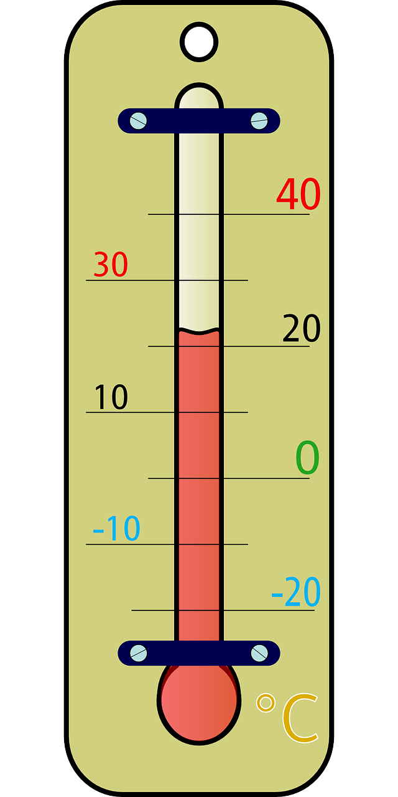
Reviewing negative numbers in a context
Negative numbers are present in everyday life.
Can you think of any?
storeys in a building or a lift
temperature
sea level

Slide 13
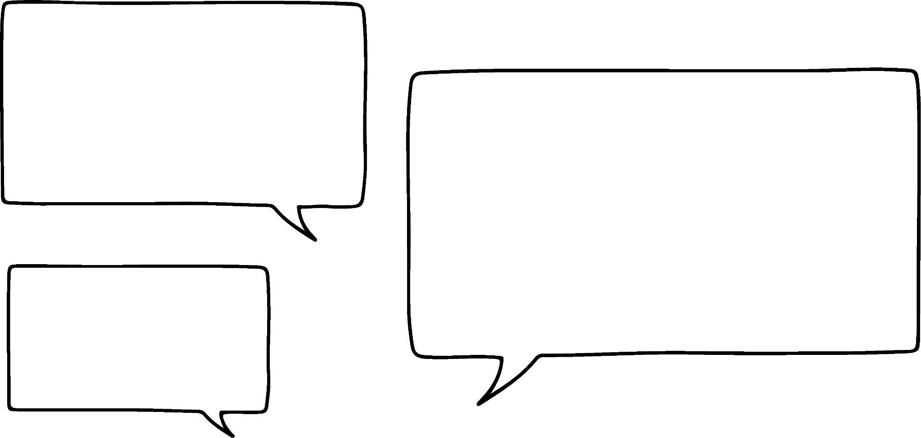

Reviewing negative numbers in a context
Negative 5 is between negative 1 and negative 7
Do you agree with Andeep?
Andeep is correct.
−10
−9
−8
−7
−6
−5
−4
−3
−2
−1
0
1
2
3
4
5
6
7
8
9
10

Slide 14
Reviewing negative numbers in a context
Negative 2 is halfway between 3 and negative 9
Do you agree with Andeep?
Andeep is not correct.
7
5
−10
−9
−8
−7
−6
−5
−4
−3
−2
−1
0
1
2
3
4
5
6
7
8
9
10

Slide 15
Reviewing negative numbers in a context
Which integer is halfway between 3 and (−9)?
6
12
−10
−9
−8
−7
−6
−5
−4
−3
−2
−1
0
1
2
3
4
5
6
7
8
9
10
Half of 12 is 6, so halfway is 6 away from (−9) and 3
(−3) is halfway between 3 and (−9)

Slide 16

Reviewing negative numbers in a context
Identify which of the following are true:
(−8) is between (−9) and (−10)
(−7) < (−5)
(−9) > (−10)
(−4) is between (−1) and (−8)

Slide 17
Reviewing negative numbers in a context
This table shows the average temperature in January in eight cities.
Alice Springs | 29℃
Jaipur | 22℃
London | 5℃
Los Angeles | 13℃
Moscow | −8℃
New York | 2℃
Quebec | −7℃
Tromsø | −6℃
Which city is the warmest?
Alice Springs
Which city is the coldest?
Moscow
What is the difference in the temperature in Moscow and New York?
8
2
−8
−7
−6
−5
−4
−3
−2
−1
0
1
2
The difference is 10℃.

Slide 18
Reviewing negative numbers in a context
This table shows the average temperature in January in eight cities.
Alice Springs | 29℃
Jaipur | 22℃
London | 5℃
Los Angeles | 13℃
Moscow | −8℃
New York | 2℃
Quebec | −7℃
Tromsø | −6℃
What is the difference in temperature between Los Angeles and Quebec?
20℃

Slide 19
Reviewing negative numbers in a context
Complete the following using either < or >:
(−3) (−1)
(−11) (−8)
(−57) (−58)
(−0.5) (−0.6)
2) Write a number in the box to make the statement true:
(−14) < < (−6)
(−324) < < (−176)
(−6) < < (−5)
(−12.8)< < (−12)

Slide 20
Reviewing negative numbers in a context
3) Which number is halfway between the following pairs of integers?
(−6) and (−10)
(−100) and (−50)
7 and (−23)
(−300) and 168
(−34) and 15

Slide 21
Reviewing negative numbers in a context
4) The table shows the average temperature in January in eight cities.
Alice Springs | 29℃
Jaipur | 22℃
London | 5℃
Los Angeles | 13℃
Moscow | −8℃
New York | 2℃
Quebec | −7℃
Tromsø | −6℃
Write the cities in order from the coldest to the warmest.
Which two cities have the greatest difference in temperature?
Which two cities have the least difference in temperature?
What is the difference in temperature between London and Los Angeles?
Find another pair of cities with the same temperature difference.

Slide 22
Reviewing negative numbers in a context
Complete the following using either < or >:
(−3) (−1)
(−11) (−8)
(−57) (−58)
(−0.5) (−0.6)
2) Write a number in the box to make the statement true:
(−14) < < (−6)
(−324) < < (−176)
(−6) < < (−5)
(−12.8) < < (−12)
<
<
>
>
e.g. (−8), (−10), (−13)
e.g. (−178), (−210), (−313)
e.g. (−5.1), (−5.4), (−5.8)
e.g. (−12.34), (−12.5), (−12.75)

Slide 23
Reviewing negative numbers in a context
3) Which number is halfway between the following pairs of integers?
(−6) and (−10)
(−100) and (−50)
7 and (−23)
(−300) and 168
(−34) and 15
(−8)
(−75)
(−8)
(−66)
(−9.5)

Slide 24
Reviewing negative numbers in a context
4) The table shows the average temperature in January in eight cities.
Alice Springs | 29℃
Jaipur | 22℃
London | 5℃
Los Angeles | 13℃
Moscow | −8℃
New York | 2℃
Quebec | −7℃
Tromsø | −6℃
Write the cities in order from the coldest to the warmest. Moscow, Quebec, Tromsø, New York, London, Los Angeles, Jaipur, Alice Springs
Which two cities have the greatest difference in temperature? Alice Springs & Moscow
Which two cities have the least difference in temperature? Quebec & Tromsø or Moscow & Quebec

Slide 25
Reviewing negative numbers in a context
4) The table shows the average temperature in January in eight cities.
Alice Springs | 29℃
Jaipur | 22℃
London | 5℃
Los Angeles | 13℃
Moscow | −8℃
New York | 2℃
Quebec | −7℃
Tromsø | −6℃
d) What is the difference in temperature between London and Los Angeles? 8℃
Find another pair of cities with the same temperature difference.
New York & Tromsø

Slide 26
Checking and securing understanding of negative numbers in context
Reviewing negative numbers in a context
Using negative numbers in a context

Slide 27

Using negative numbers in a context
Izzy gets her school lunch from the canteen.
She forgot to ask her dad to top up her account.
She has £1.00 credit.
Her lunch costs £3.00.
Does she have enough money?
No, she does not have enough money.
If she buys the lunch, what will the balance on her account be?
She can pay £1.00 of the cost so will owe the canteen £2.00.
Her balance would be (−£2.00)

Slide 28


Using negative numbers in a context
Sofia buys an apple, a sandwich and a bottle of water.
She has £2.00 on her account.
What is the balance on her account after she has bought those items?
Canteen Price List
Apple
Melon pot
Meal deal
Sandwich
Ice lolly
Fruit juice
Water
45p
75p
£2.65
£1.85
80p
85p
95p
Total cost = £0.45 + £1.85 + £0.95
Total cost = £3.25
Account balance = £2.00 − £3.25
(−£3.25)
(−£1.25)
(−£2.00)
(−£1.25)
£0.00
£2.00

Slide 29

Using negative numbers in a context
Jacob buys a meal deal and an ice lolly.
He has £0.75 on his account.
What is the balance on his account after he has bought those items?
Canteen Price List
Apple
Melon pot
Meal deal
Sandwich
Ice lolly
Fruit juice
Water
45p
75p
£2.65
£1.85
80p
85p
95p
Total cost = £2.65 + £0.80
Total cost = £3.45
Account balance = £0.75 − £3.45
(−£3.45)
(−£2.70)
(−£0.75)
(−£2.70)
£0.00
£0.75

Slide 30
Using negative numbers in a context
Match each box on the left to the new account balance on the right.
Account balance
Amount spent
New account balance
£1.00
£3.50
(−£0.80)
£2.00
£2.80
(−£1.25)
£1.50
£3.50
(−£1.35)
£2.50
£3.75
(−£2.50)
£1.25
£2.60
(−£2.00)

Slide 31
Using negative numbers in a context
Canteen Price List
Work out the new balance for each student:
Current balance | Bought from the canteen | New balance
£2.00 | Meal deal and an ice lolly
£1.50 | A melon pot, sandwich and a fruit juice
£3.25 | A meal deal and bottle of water
£2.80 | An apple, melon pot and a sandwich
£0.60 | A melon pot
£1.25 | A meal deal and a fruit juice
£0.25 | A sandwich, ice lolly and bottle of water
Apple
Melon pot
Meal deal
Sandwich
Ice lolly
Fruit juice
Water
45p
75p
£2.65
£1.85
80p
85p
95p

Slide 32
Using negative numbers in a context
2) The table shows the average temperature in January in eight cities.
Alice Springs | 29℃
Jaipur | 22℃
London | 5℃
Los Angeles | 13℃
Moscow | −8℃
New York | 2℃
Quebec | −7℃
Tromsø | −6℃
Complete the following sentences:
Tromsø is ℃ warmer than . and ℃ colder than .
New York is ℃ warmer than . and ℃ colder than .
Quebec is ℃ warmer than . and ℃ colder than .
London is ℃ warmer than . and ℃ colder than .

Slide 33
Using negative numbers in a context
Work out the new balance for each student:
Canteen Price List
Current balance | Bought from the canteen | New balance
£2.00 | Meal deal and an ice lolly | (−£1.45)
£1.50 | A melon pot, sandwich and a fruit juice | (−£1.95)
£3.25 | A meal deal and bottle of water | (−£0.35)
£2.80 | An apple, melon pot and a sandwich | (−£0.25)
£0.60 | A melon pot | (−£0.15)
£1.25 | A meal deal and a fruit juice | (−£2.25)
£0.25 | A sandwich, ice lolly and bottle of water | (−£3.35)
Apple
Melon pot
Meal deal
Sandwich
Ice lolly
Fruit juice
Water
45p
75p
£2.65
£1.85
80p
85p
95p

Slide 34
Using negative numbers in a context
2) The table shows the average temperature in January in eight cities.
Alice Springs | 29℃
Jaipur | 22℃
London | 5℃
Los Angeles | 13℃
Moscow | −8℃
New York | 2℃
Quebec | −7℃
Tromsø | −6℃
Complete the following sentences:
e.g. Tromsø is 2℃ warmer than Moscow and 11℃ colder than London.
e.g. New York is 9℃ warmer than Quebec and 3℃ colder than London.
e.g. Quebec is 1℃ warmer than Moscow and 29℃ colder than Jaipur.
e.g. London is 3℃ warmer than New York and 24℃ colder than Alice Springs.

Slide 35
Checking and securing understanding of negative numbers in context
Negative numbers are present in everyday life.
Negative numbers exist as they represent values below zero.
A context can help when dealing with negative numbers.
E.g. Which is a colder temperature? Rather than which is smaller.

Slide 36

© Oak National Academy 2023.
Produced in partnership with Mathematics in Education and Industry.
Licensed on the Open Government Licence v3.0, except where otherwise stated. See Oak terms and conditions.

